Slide 1
LOGISTIC
REGRESSION

Slide 2
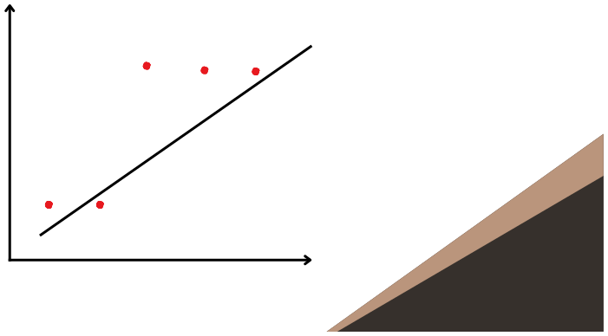
Logistic Regression
categorical outcomes, especially binary outcomes (Yes/No, 0/1, Pass/Fail). 🔍 Unlike linear regression, it doesn’t predict a number — it predicts the probability of a class label.
LogisticRegressionisaclassificationalgorithmusedtopredict
Study hours
Result
1
0
1
2
0
3
1
0.5
0
4
1
5
1
1
2
3
4
5

Slide 3
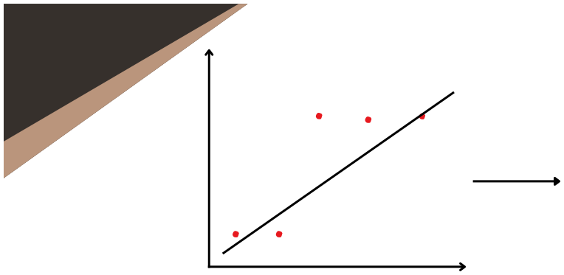
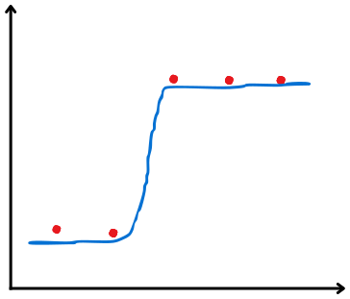

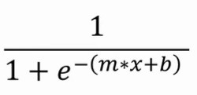
Study hours
Result
1
1
0
0.5
y = mx +c
2
0
0
3
1
4
1
1
2
3
4
5
5
1
1
0.5
0
1
2
3
4
5

Slide 4

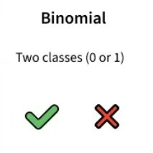

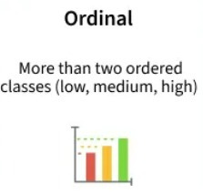
Types

Slide 5
Linear vs Logistics
Linear regression is used to predict the continuous dependent variable using a given set of independent variables. It is used for solving regression problem. In this we predict the value of continuous variables. In this we find best fit line. The output must be continuous value, such as price, age etc. It required linear relationship between dependent and independent variables.
Logistic regression is used to predict the categorical dependent variable using a given set of independent variables. It is used for solving classification problems. In this we predict values of categorical variables. In this we find S-Curve. Output must be categorical value such as 0 or 1, Yes or no etc. It not required linear relationship.

